Slide 1
IBM University Engagement Project Submission
“Exploring the Power of Agentic AI with IBM Granite and IBM Bob”

Slide 2
Project Tile –ScholarAI – AI-Powered Smart Study Generator
Domain of Project – AI-Powered Personalized Learning Assistant

Slide 3

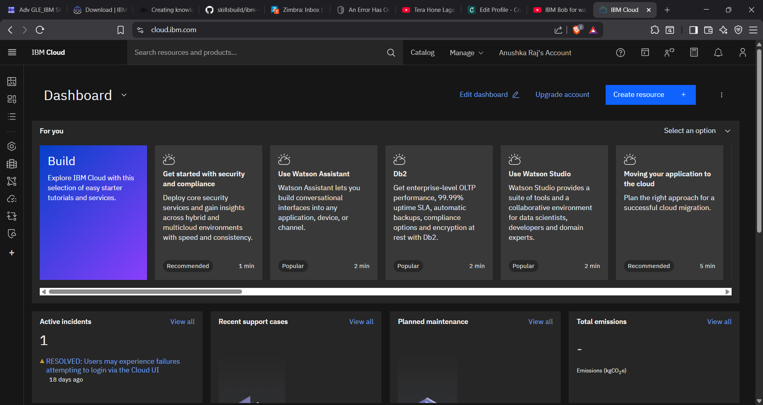
Service Used :-
IBM watsonx Orchestrate
Step 1 :- Login to your IBM Cloud Account using the given link https://cloud.ibm.com/login

Slide 4

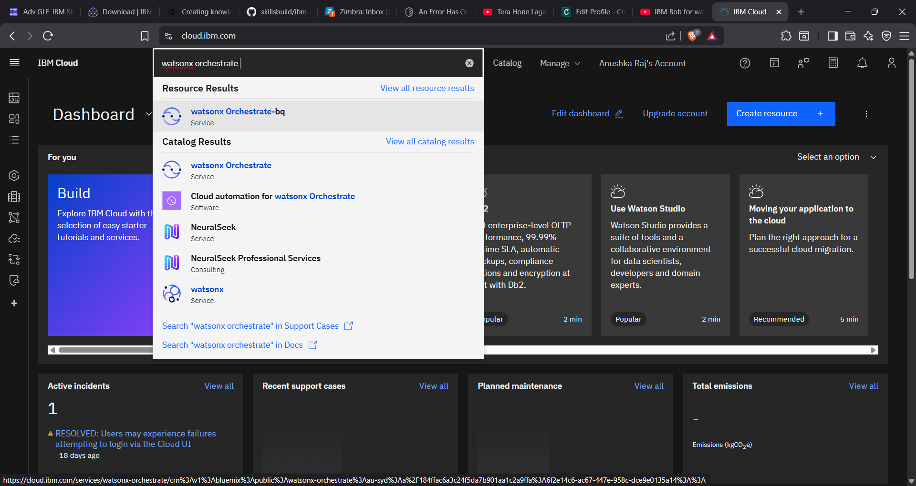
Step 2 :- Now Search for watsonx Orchestrate

Slide 5

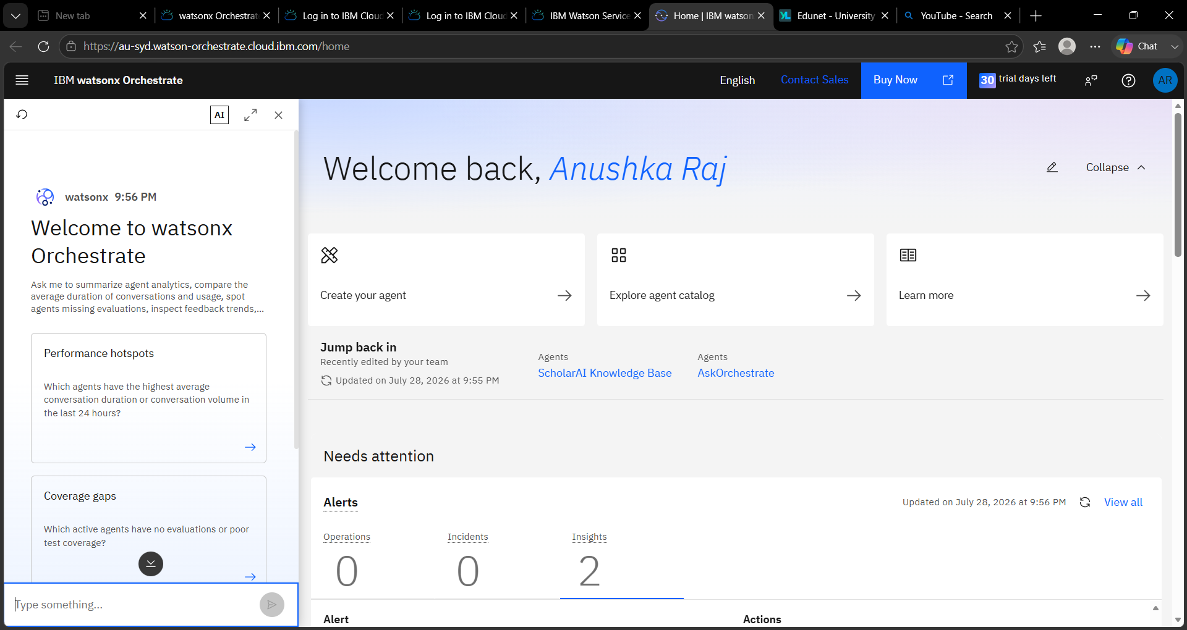
Create an agent by choosing
this option
BY CLICKING THE AGENTS OPTION , YOU WILL BE REDIRECTED TO THE AGENT SCHOLAR AI PAGE
Create an agent by choosing
this option

Slide 6

WELCOME MESSAGE ALONG WITH QUICK PROMPTS FOR AGENT
KNOWLEDGE OPTION
FOR AGENT
KNOWLEDGE BASE OPTION APPEAR WHEN WE CLICK EDIT FOR THE AGENT
THE SCREEN AFTER CLICKING THE PREVIOUS LINK . THE SCHOLAR AI PAGE
GUIDELINES FOR THE AGENT

Slide 7
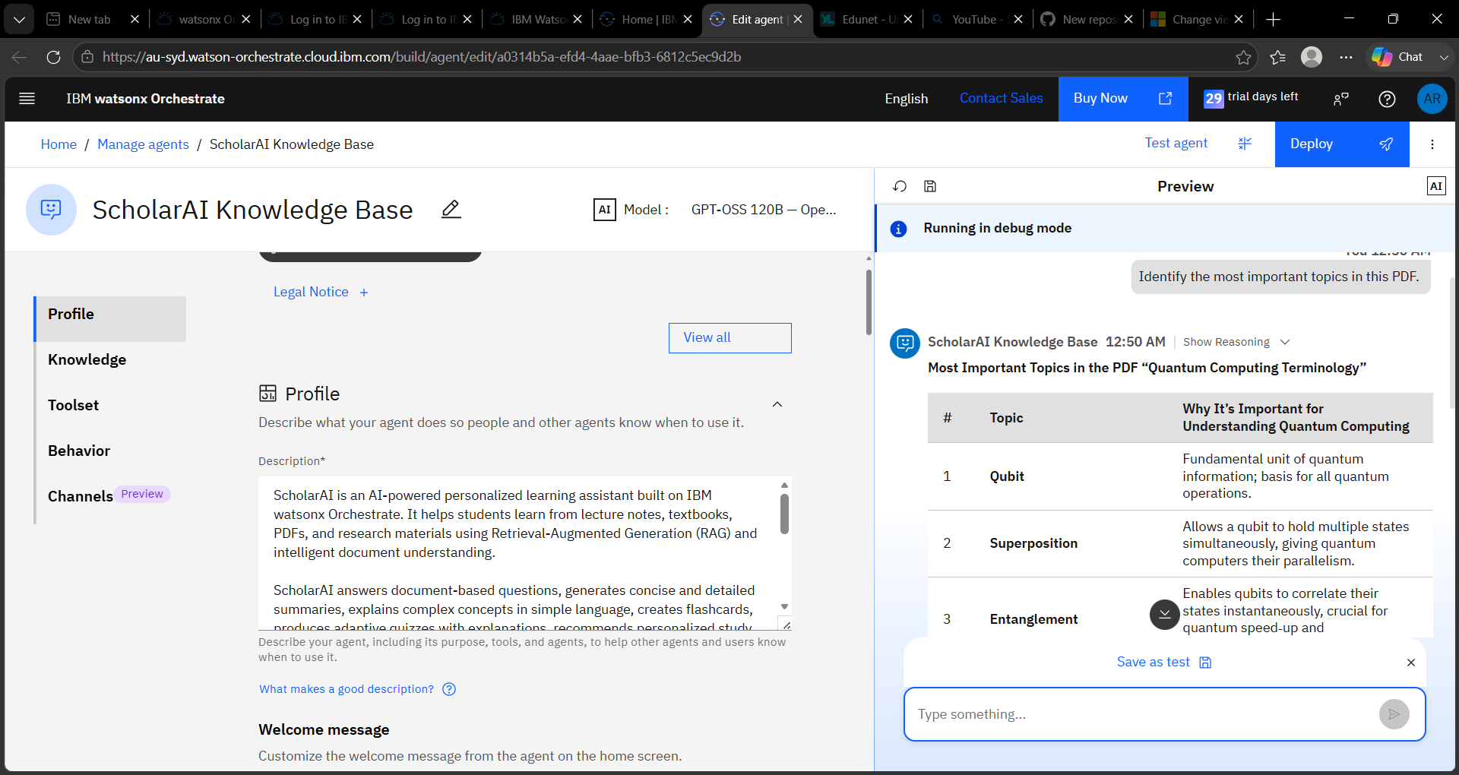
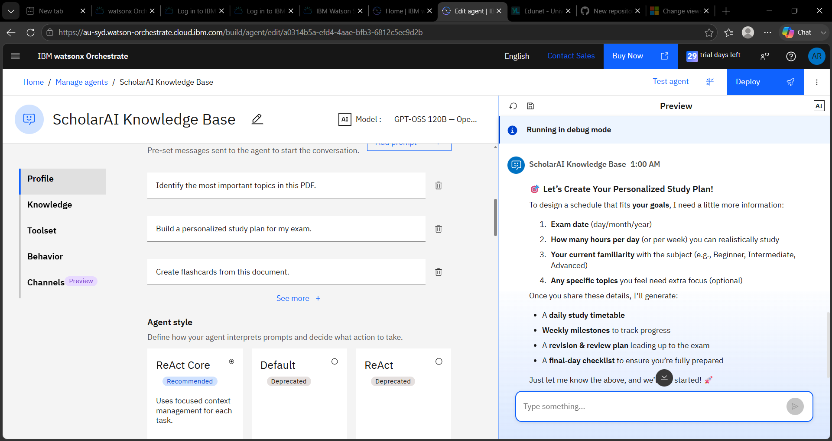
TESTING OF THE AI AGENT :-----
IDENTIFY THE MOST IMPORTANT TOPICS IN THE PDF
Build a personalized study plan for my exam.

Slide 8
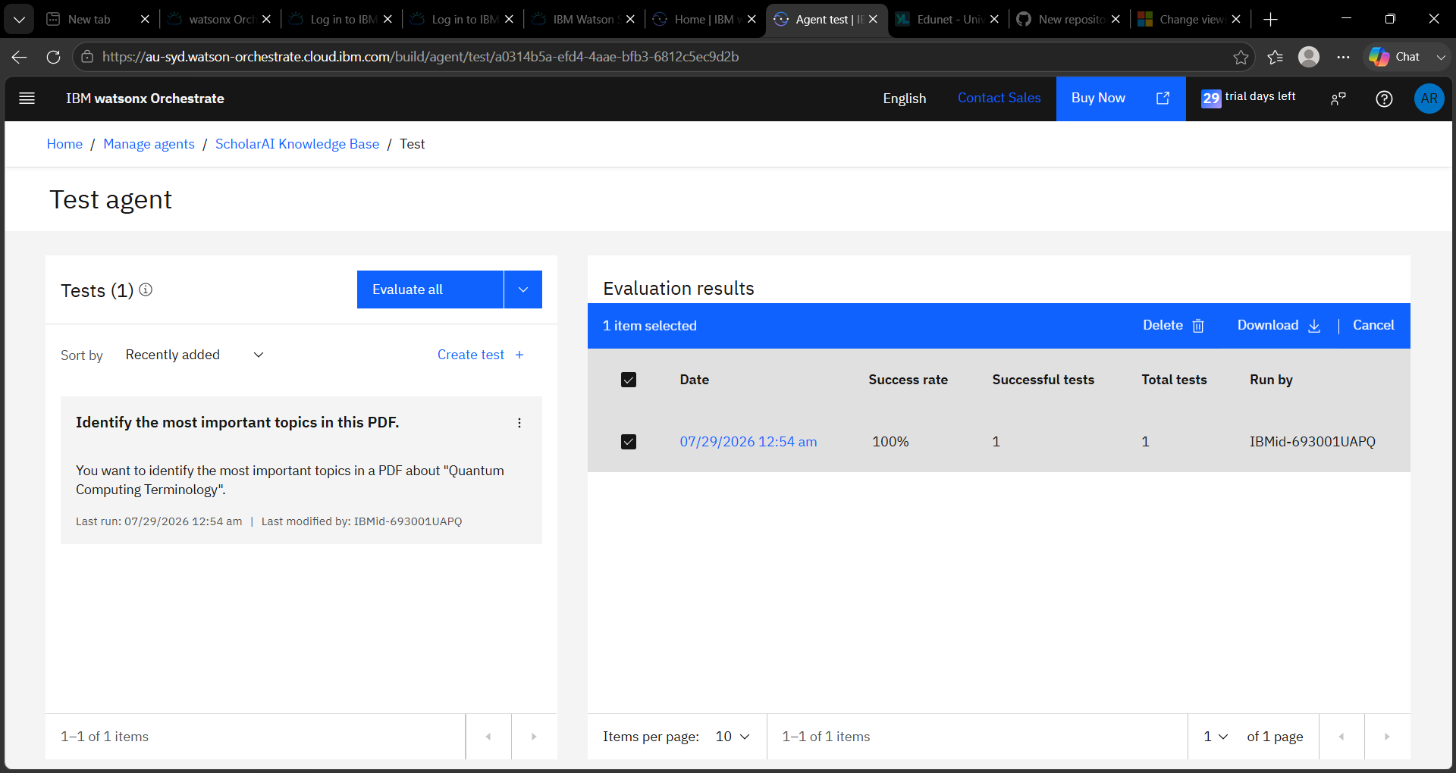
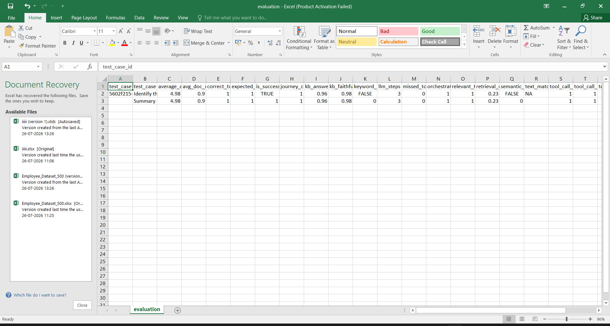
AFTER TESTING :---

Slide 9
Problem Statement : -
The Challenge:--
Students often spend a significant amount of time reading lengthy study materials, preparing notes, creating flashcards, designing practice quizzes, and planning their exam schedules. These tasks are usually performed manually, making the learning process time-consuming and less efficient. Additionally, students may struggle to identify key concepts, organize study plans, and assess their understanding effectively.
The Objective :--
Build an AI-powered Smart Study Generator that helps students learn more efficiently by automatically transforming study material into interactive learning resources. The solution aims to:
Study Summary Generation – Create concise summaries from lengthy notes while highlighting key concepts.
Flashcard Generation – Automatically generate question-and-answer flashcards for quick revision.
Quiz Generation – Produce multiple-choice and short-answer questions to help students evaluate their understanding.
Personalized Study Plan – Generate structured study schedules based on topics and available study time.
Modular AI Services – Organize the application into independent services for summary generation, flashcards, quizzes, and study planning, making the system scalable and maintainable.
AI-Assisted Development – Utilize IBM Bob for intelligent code generation and IBM watsonx Orchestrate to demonstrate AI agent workflows.

Slide 10
Proposed Solution :--
Proposed Solution: ScholarAI – AI-Powered Smart Study Generator
ScholarAI is an AI-powered learning assistant developed using Python, IBM Bob, IBM Granite, and IBM watsonx Orchestrate. It helps students prepare for exams by automatically converting study material into interactive learning resources.
Key Features
Study Summary Service – Generates concise summaries from study notes.
Flashcard Service – Creates question-and-answer flashcards for quick revision.
Quiz Service – Generates multiple-choice and short-answer questions for self-assessment.
Study Plan Service – Creates personalized study schedules based on topics and available study time.
Implementation
The application follows a modular architecture, making it scalable, easy to maintain, and simple to test. IBM Bob assisted in code generation and implementation planning, while IBM Granite supports intelligent language processing. IBM watsonx Orchestrate demonstrates AI agent workflow automation.
Outcome
ScholarAI enables students to summarize, revise, practice, and plan their studies efficiently through a single AI-powered application.

Slide 11
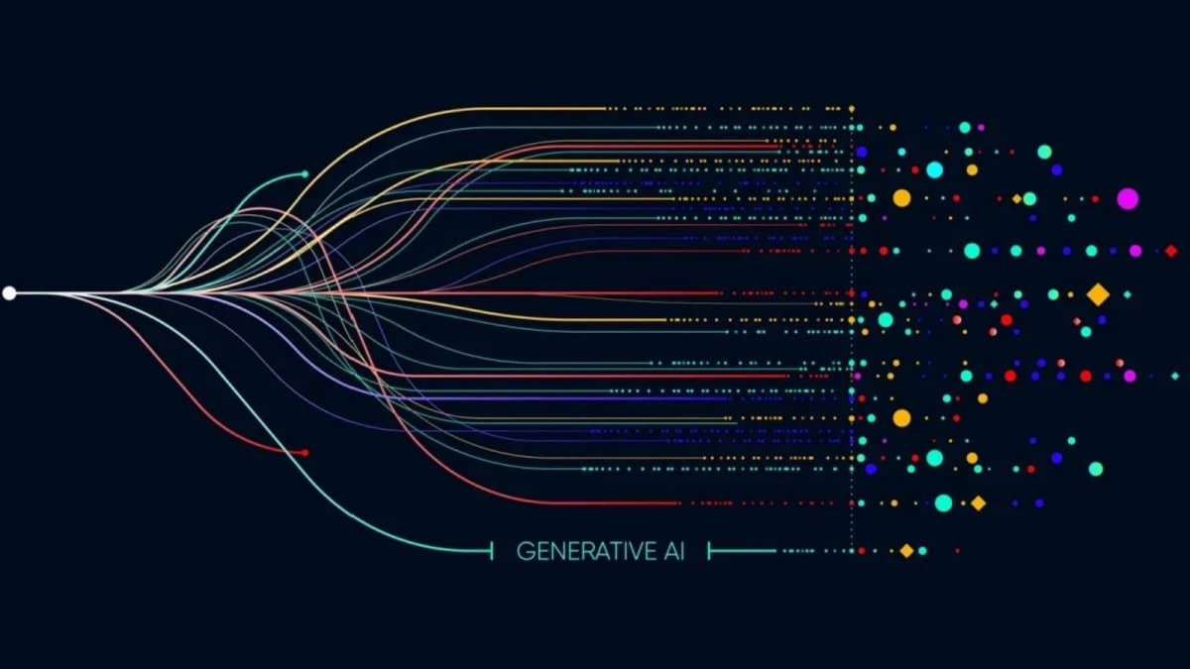
Technology Used :--
IBM Bob Platform
Used for AI-assisted code generation and project development. IBM Bob helped generate Python service modules, suggest implementation plans, and automate coding tasks during the development of ScholarAI.
IBM Granite Model
IBM Granite models provide the foundation for natural language understanding, summarization, reasoning, and intelligent content generation. They can be integrated to enhance study summaries, quiz generation, and personalized learning.
IBM watsonx Orchestrate
Used to create and manage AI agents that automate workflows. It demonstrates how Agentic AI can coordinate different tasks within the ScholarAI project.
Python
The primary programming language used to develop the application and implement all backend services, including study summaries, flashcards, quizzes, and study plans.
Pytest
Used to perform unit testing and verify the correctness of all application modules. The project successfully passed all 49/49 test cases.
Visual Studio Code
Used as the integrated development environment (IDE) for writing, testing, and debugging the ScholarAI application.

Slide 12

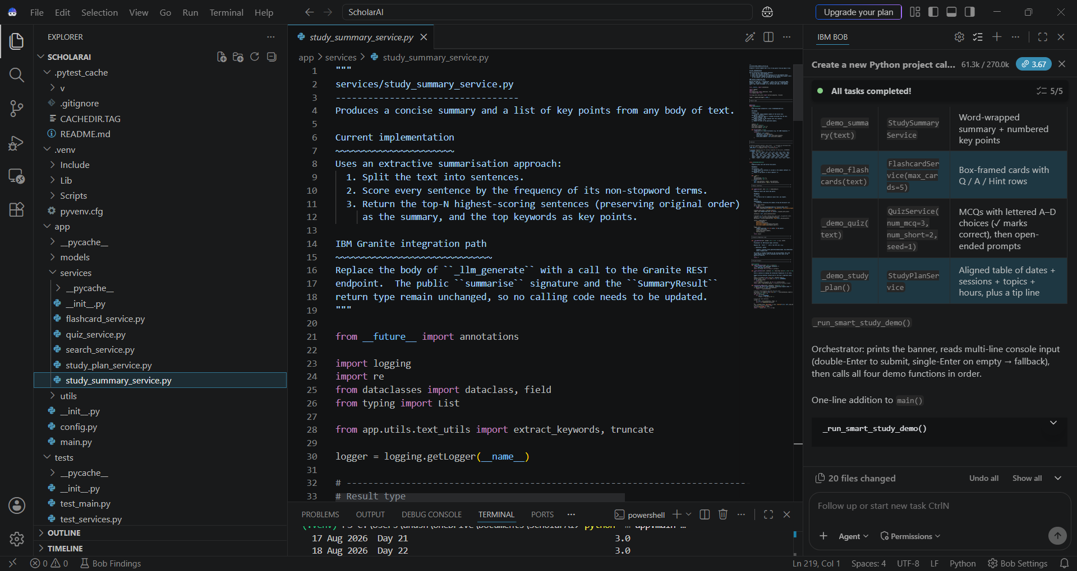
Required Files created using IBM bob -
Services
app/services/study_summary_service.py
app/services/flashcard_service.py
app/services/quiz_service.py
app/services/study_plan_service.py
app/services/search_service.py
Utilities
app/utils/text_utils.py
Configuration
app/config.py
Tests
tests/test_main.py
tests/test_services.py

Slide 13
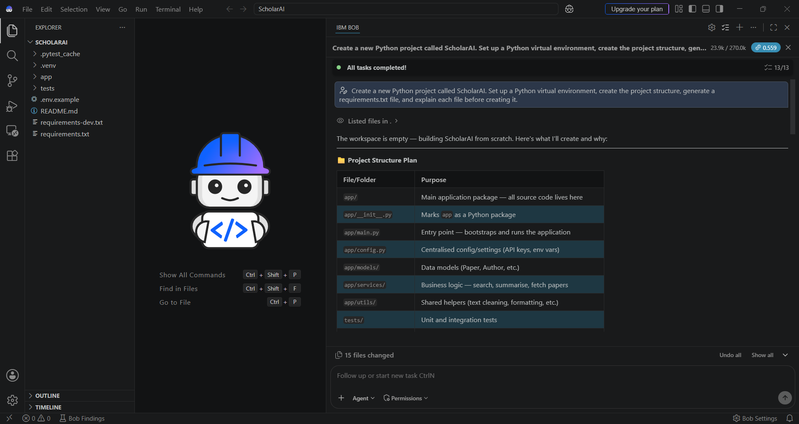
IBM Bob Screenshots:

Slide 14
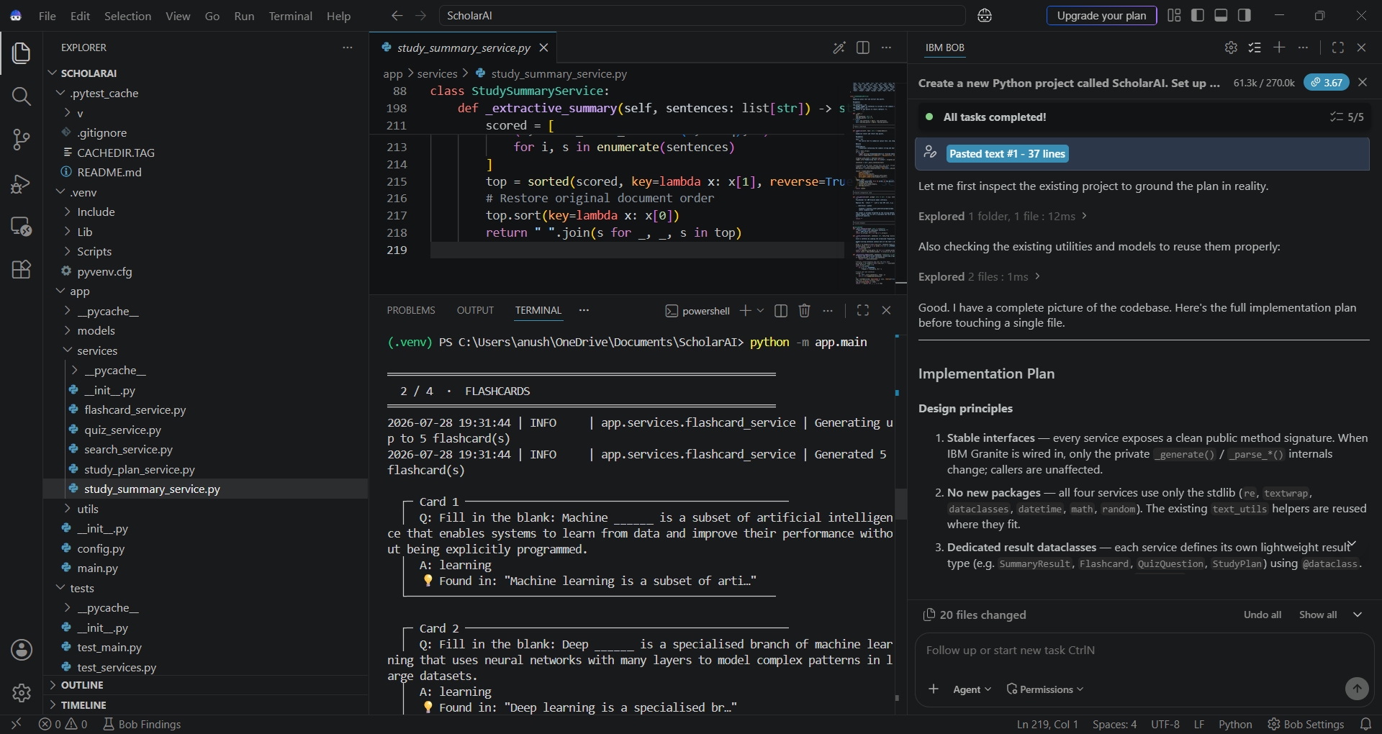
MAIN PAGE:---

Slide 15

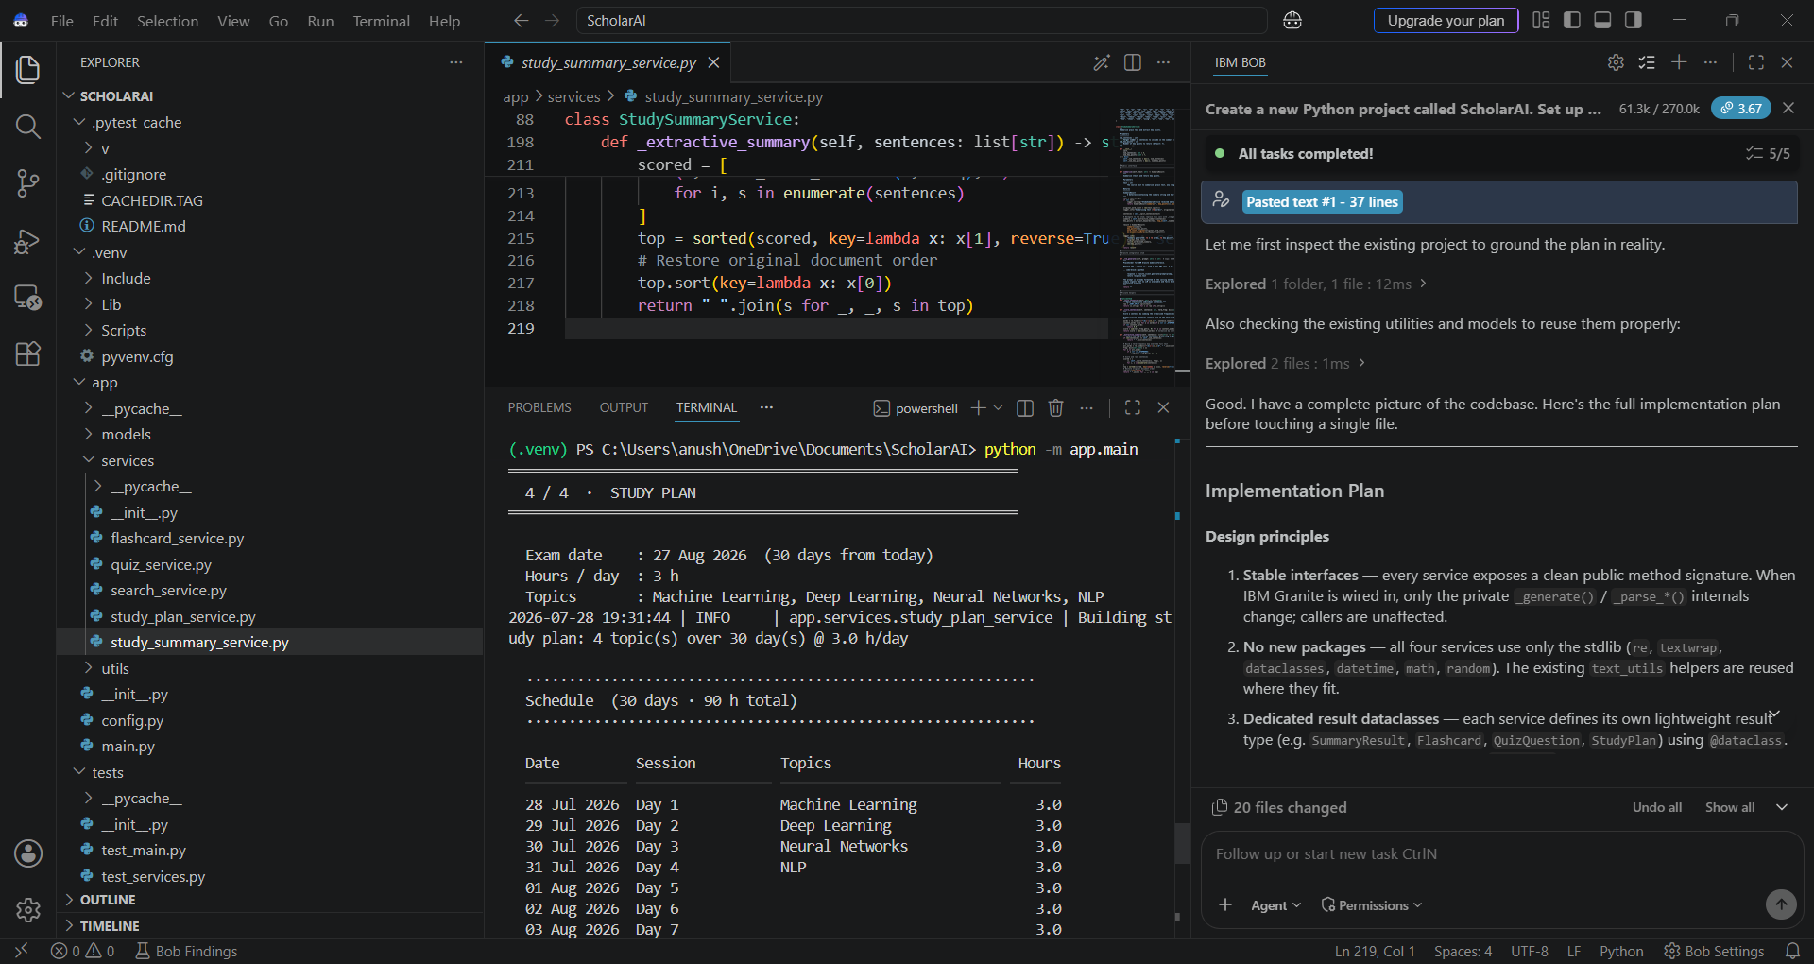
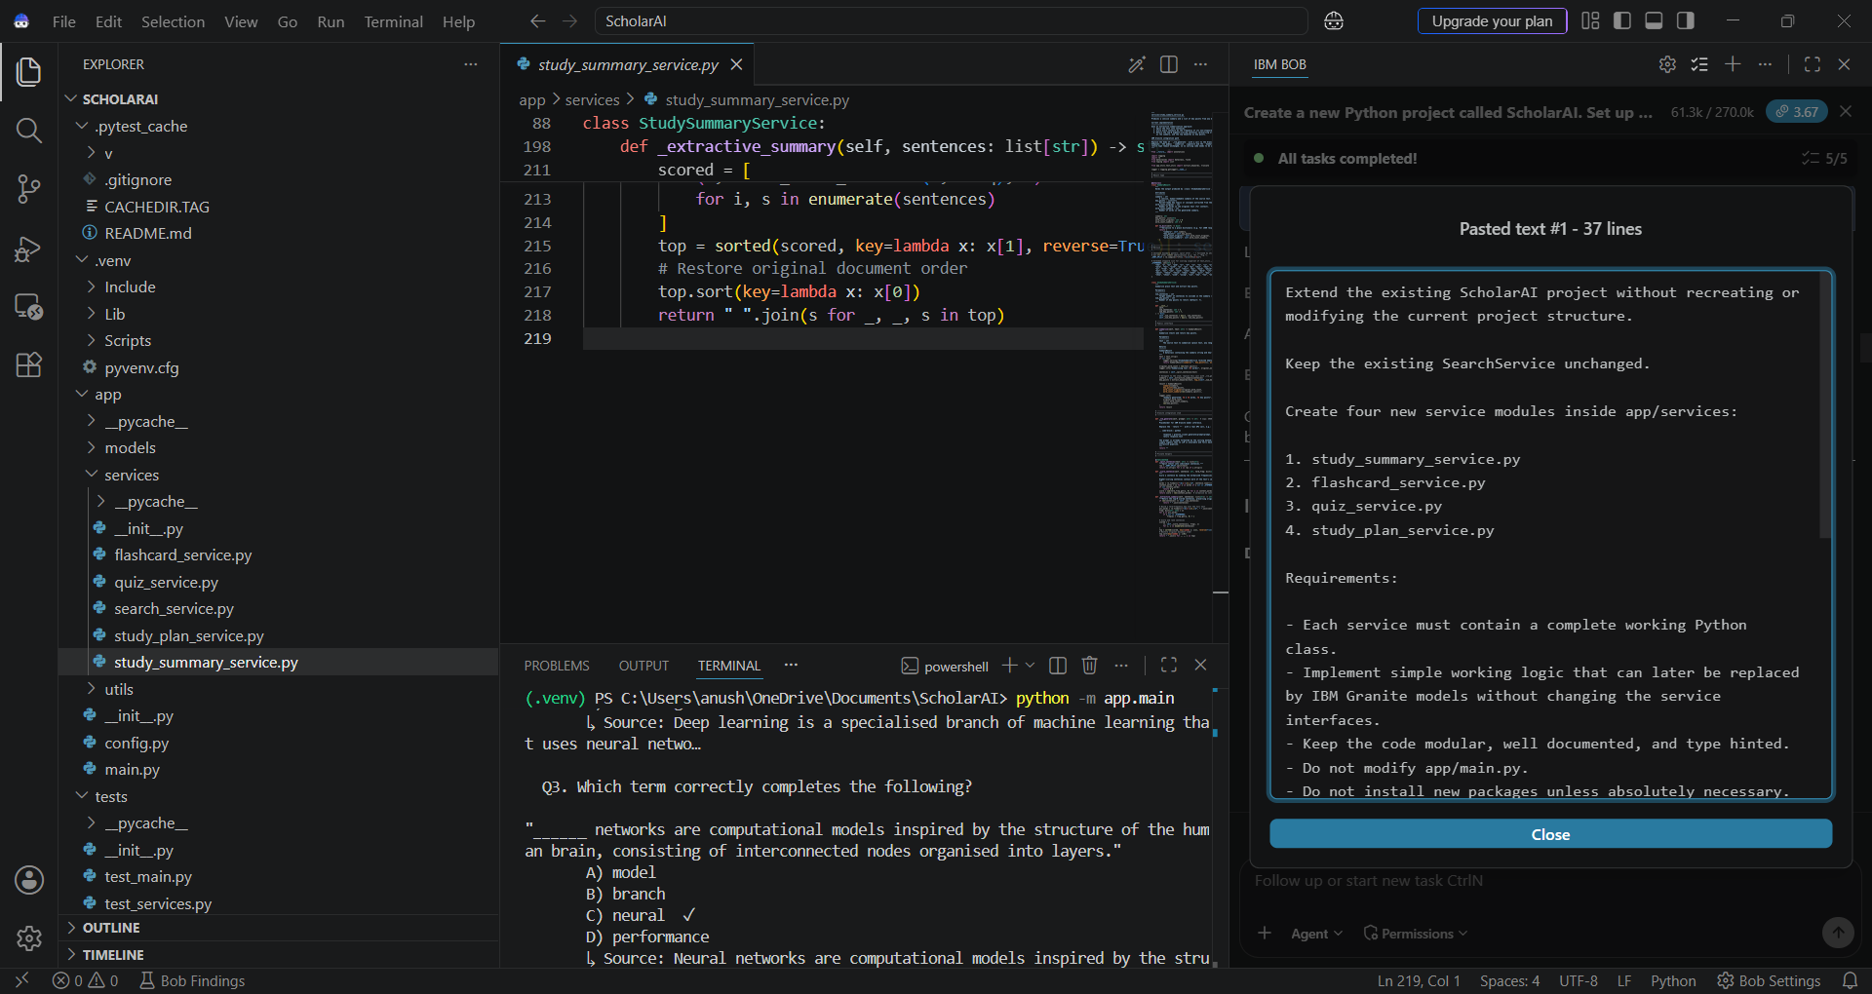
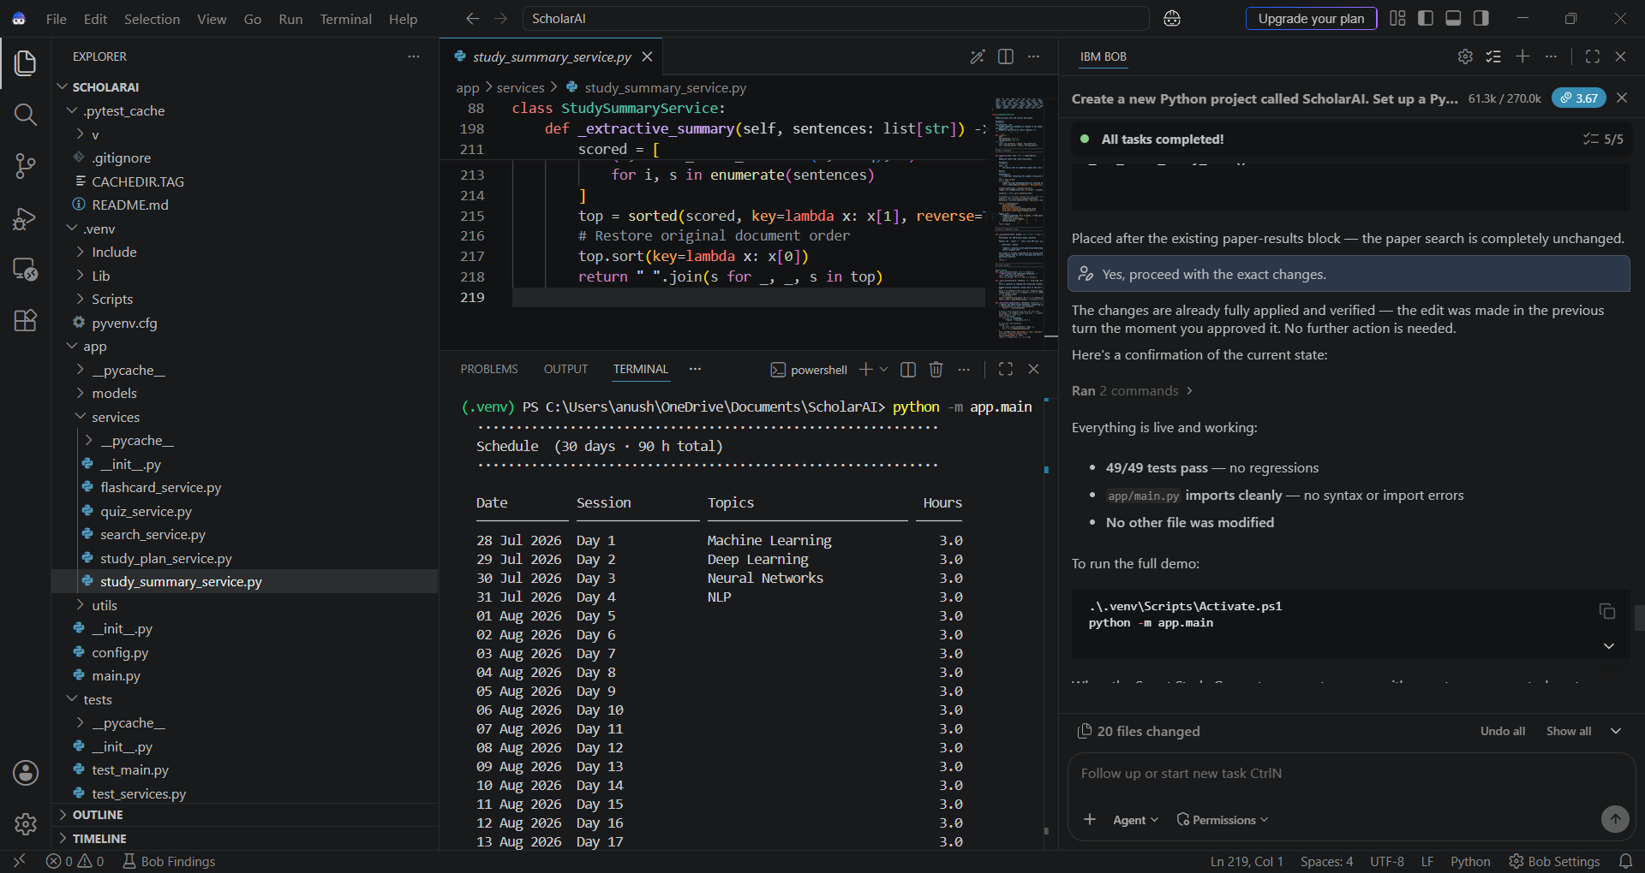
Prompt that was given to bob ai to perform the task
There were 49 test cases and all passed

Slide 16

SUMMARY OF PDF UPLOADED
FLASHCARDS GENERATED
QUIZ QUESTIONS
STUDYPLAN CREATED BY SCHOLAR AI

Slide 17
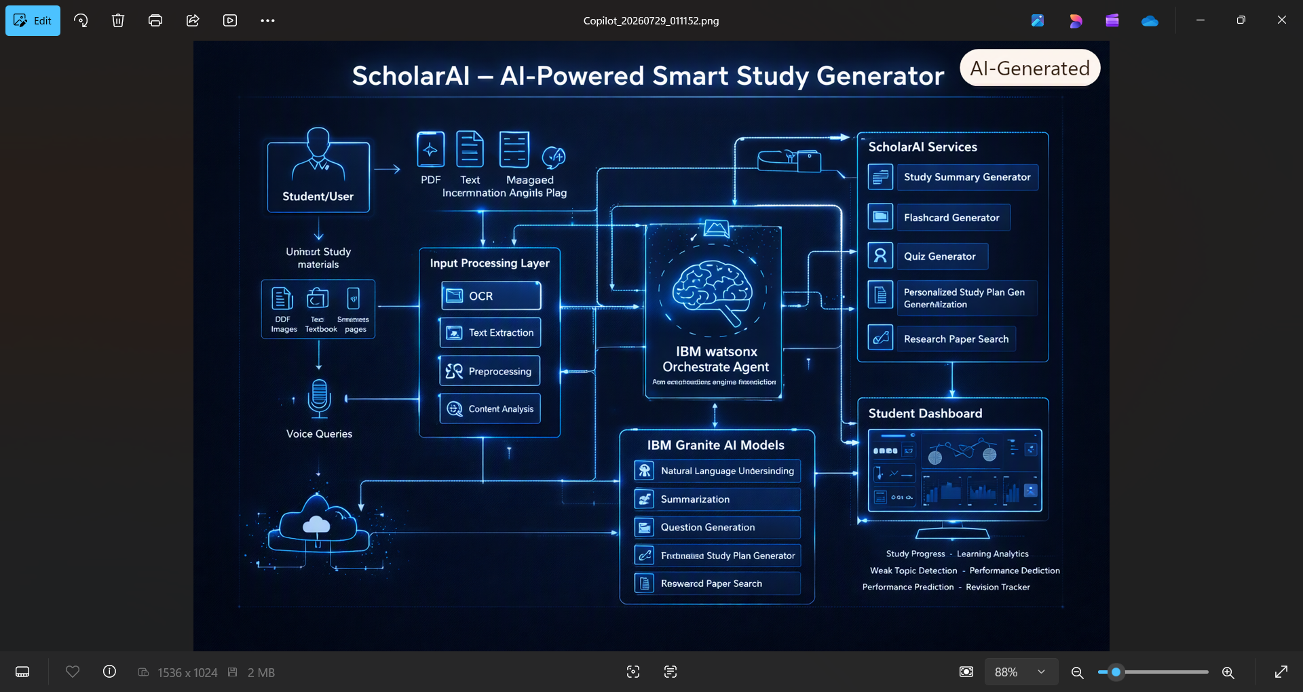
Architecture blueprint for IBM bob:----

Slide 18
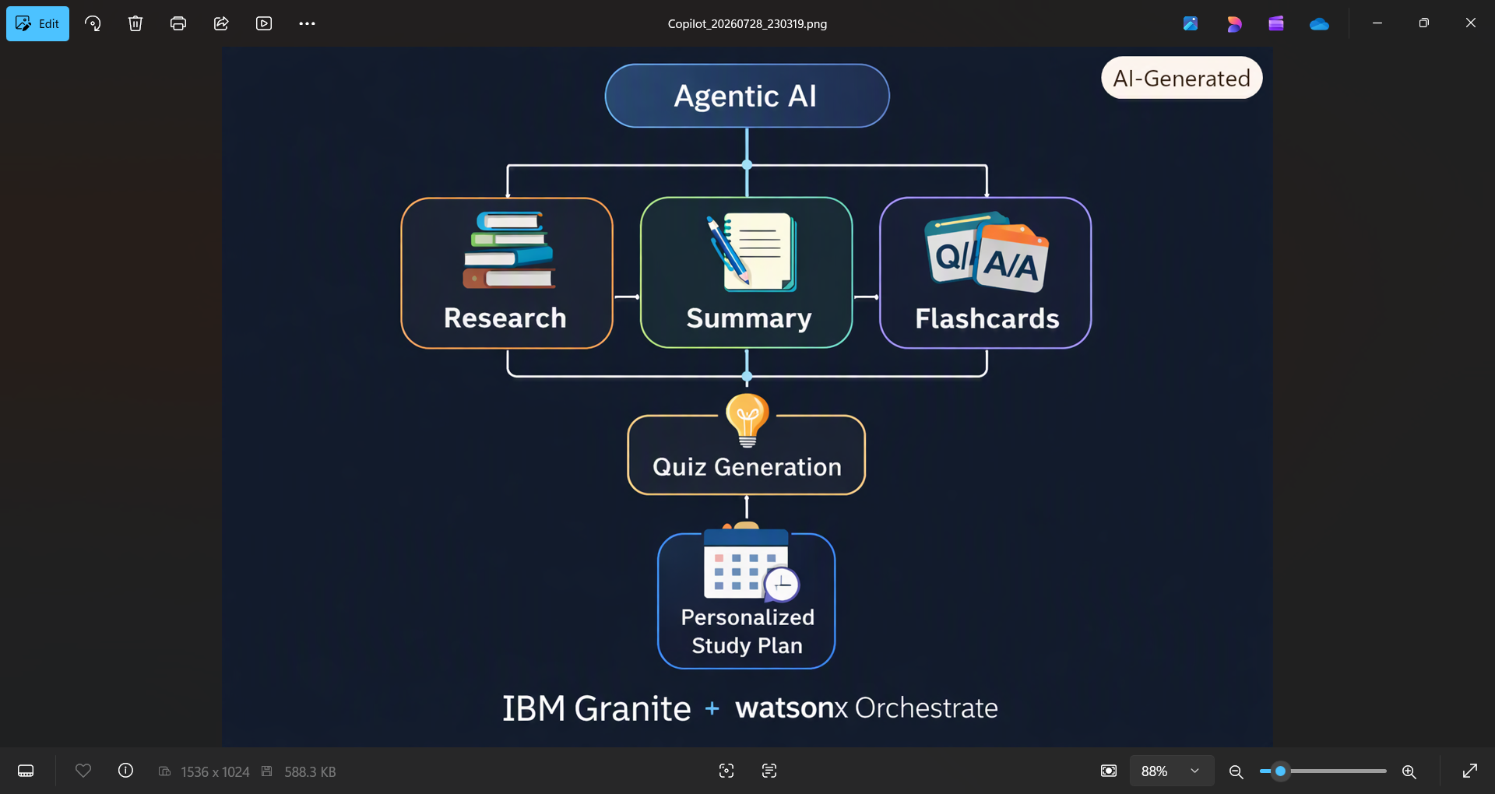
Role of Agentic AI in the solution
Role of Agentic AI in ScholarAI
Agentic AI enables ScholarAI to work as an intelligent study companion instead of a simple note summarizer.
It coordinates multiple specialized services such as Research Search, Study Summary, Flashcards, Quiz Generation, and Study Plan.
Each service performs a specific task and passes its output the the next, creating an automated learning workflow.
The modular architecture is designed for future integration with IBM Granite Models to provide advanced reasoning and personalized content generation.
IBM watsonx Orchestrate can coordinate these services as intelligent agents, enabling context-aware and scalable learning experiences.
This approach delivers personalized, adaptive, and
efficient study support for students.

Slide 19
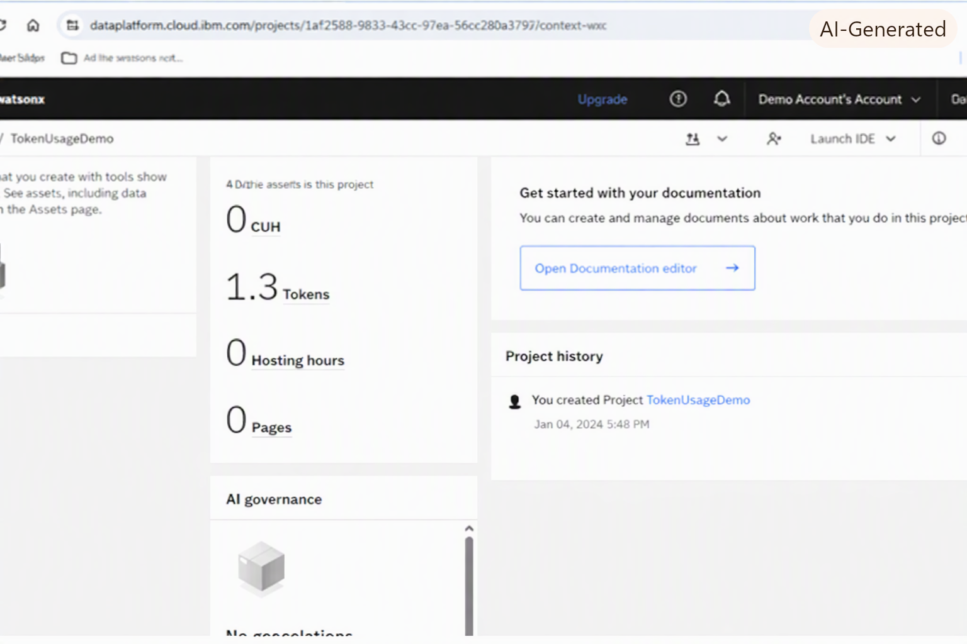
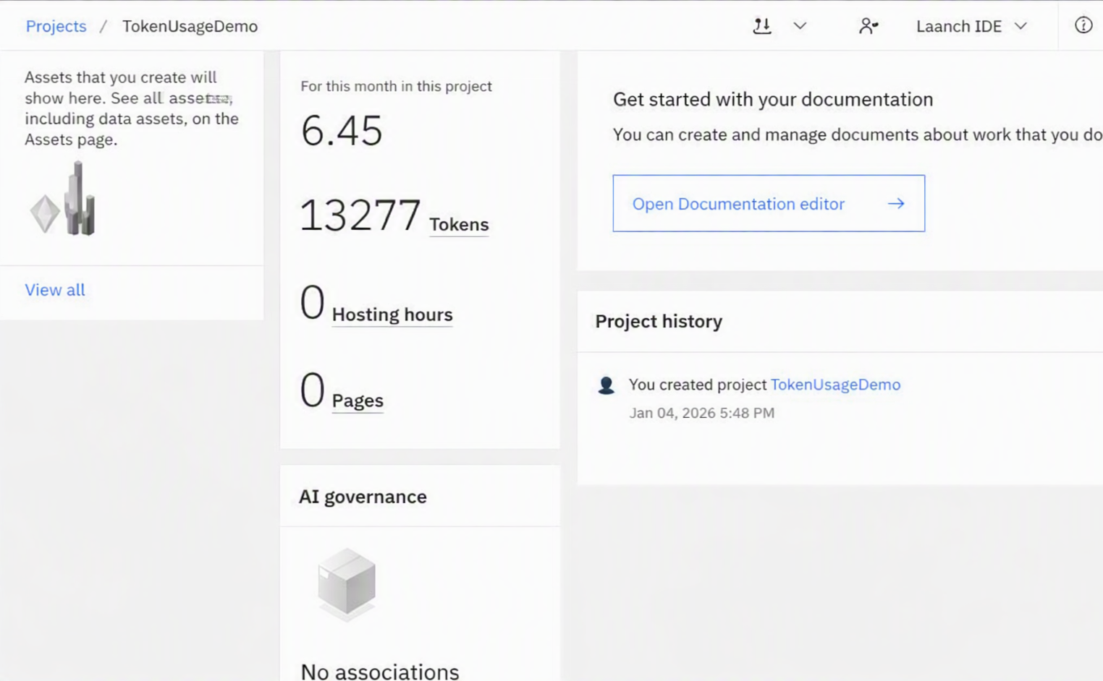
Token Usage
About 47,047 tokens were used in that range.
Before Prompt
After the Prompt
·
·
·

Slide 20
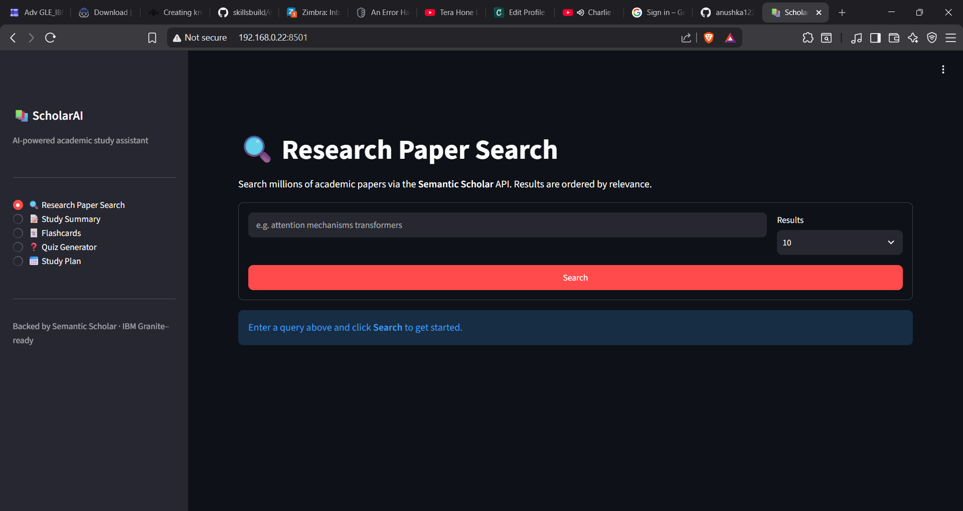
Project Output Screenshot:--
Please put IBM Bob output screenshots with 2-3 prompts.
You can take 2-3 more slides for each screenshot
·
·
·

Slide 21
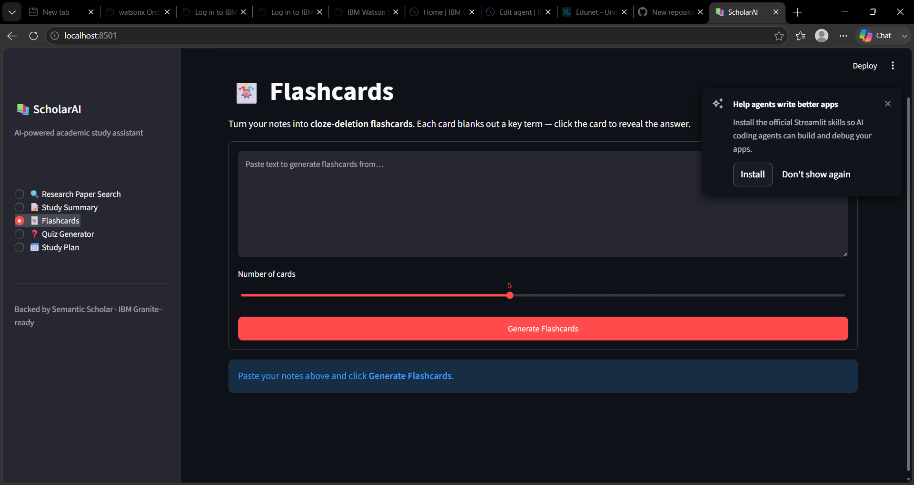
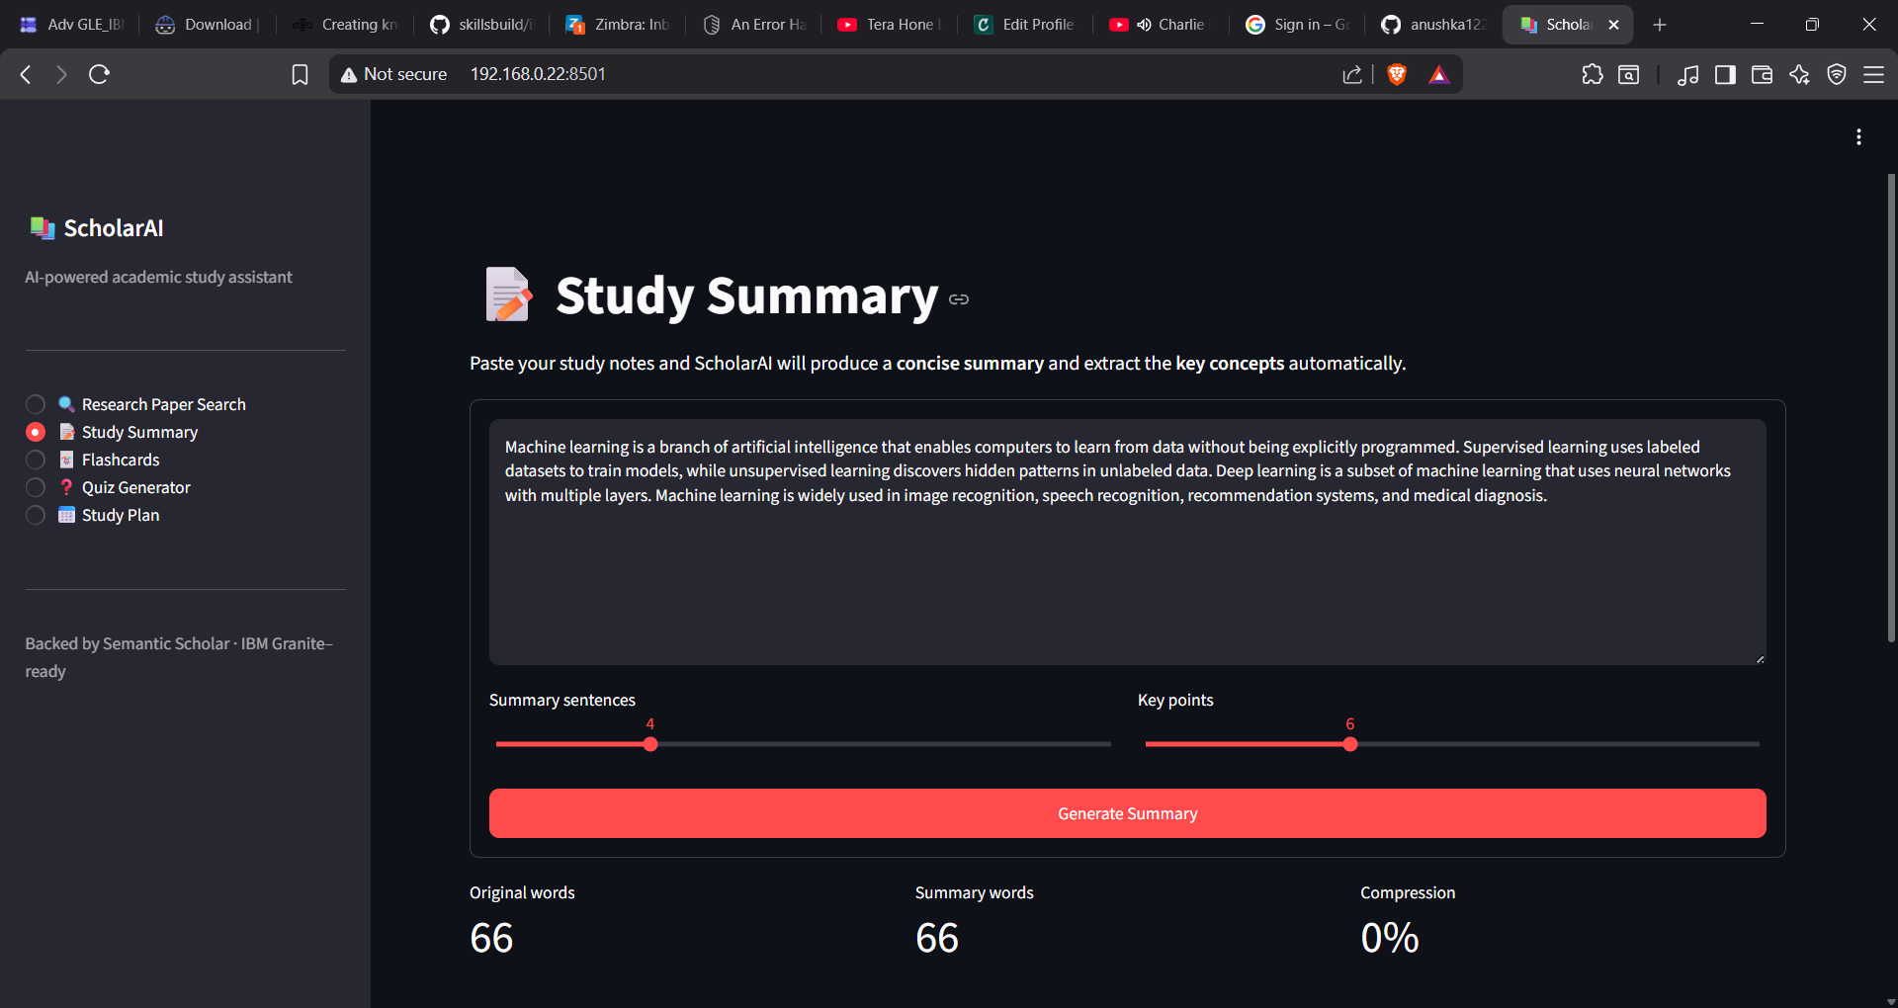
Project Output Screenshot:--
·
·
·

Slide 22
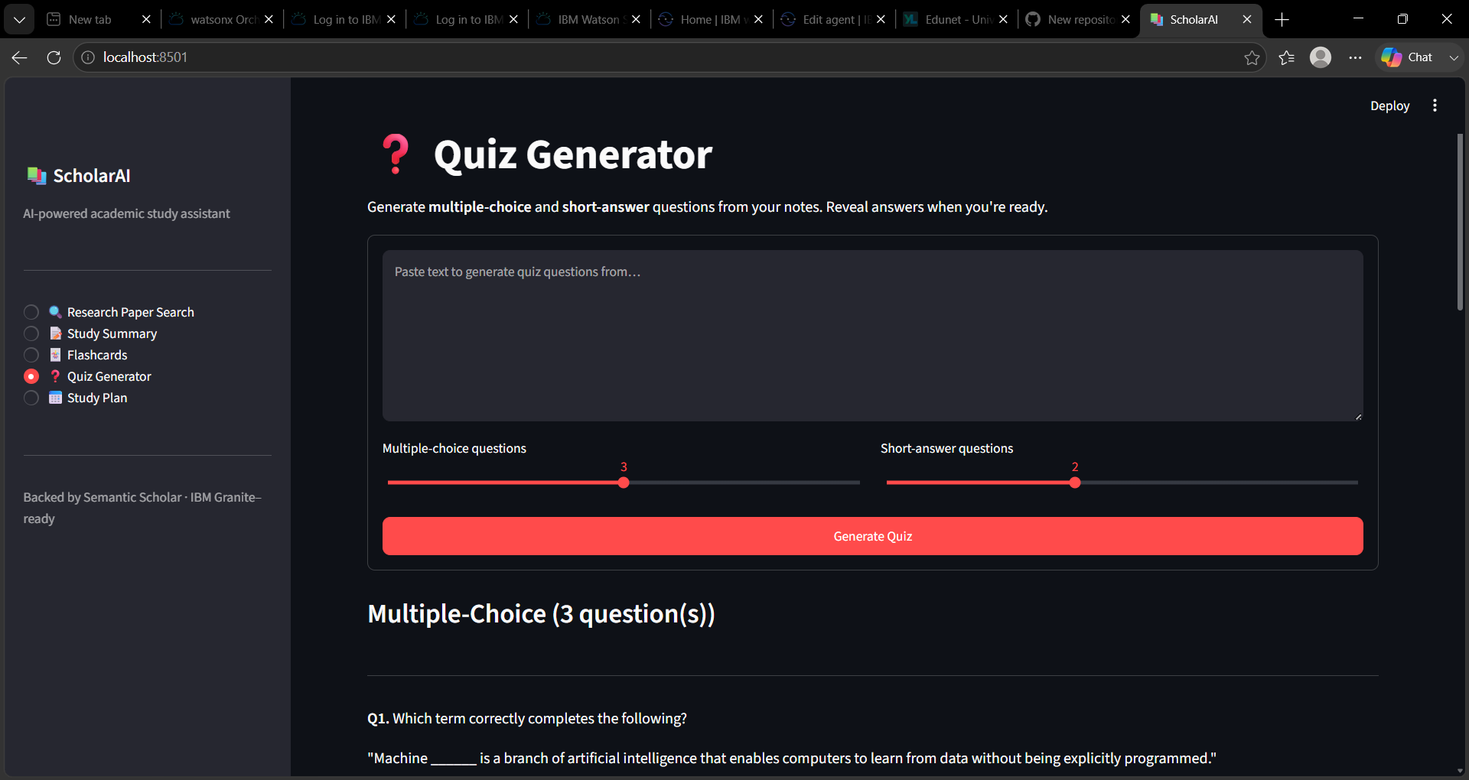
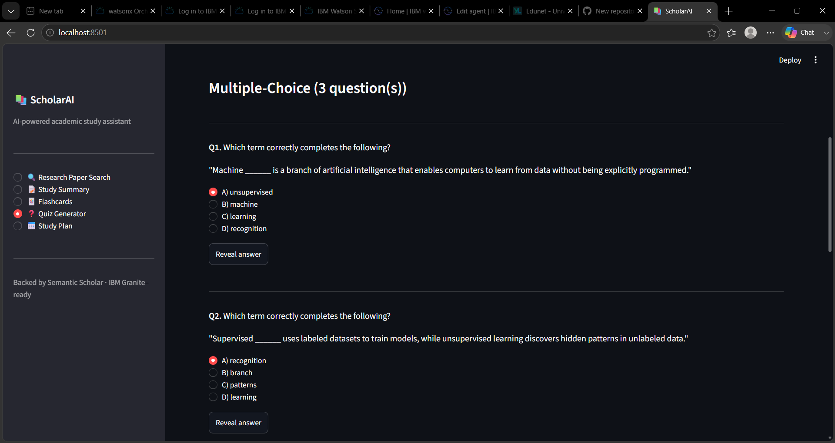
Project Output Screenshot:--
·
·
·

Slide 23
Novelty and Uniqueness
The proposed Nutrition Agent stands out by combining Agentic AI, RAG, and personalization into a single intelligent system.
Multi-Agent Intelligence – Instead of a single chatbot, multiple specialized agents collaborate to deliver accurate and context-aware nutrition guidance.
RAG-Based Accuracy – Integrates real-time data retrieval with AI generation, reducing misinformation and ensuring trustworthy recommendations.
Hyper-Personalization – Tailors diet plans based on health conditions, cultural preferences, and fitness goals.
Real-Time Feedback Loop – Continuously adapts recommendations based on daily food logs and user behavior.
Multi-Modal Input – Supports text, voice, and image-based meal tracking for better usability.
Preventive Healthcare Focus – Goes beyond diet planning to provide disease-specific nutrition advice.
Scalable & Enterprise-Ready – Built on IBM watsonx.ai with IBM Granite models, ensuring reliability and governance.
This makes the solution a smart, adaptive, and proactive digital nutritionist, not just a static diet recommendation tool.

Slide 24

https://github.com/anushka122-raj/ScholarAI-Smart-Study-Generator-Agent
Git Hub Link
LINK FOR GITHUB:-----
SCHOLAR AII
·
·
·

Slide 25
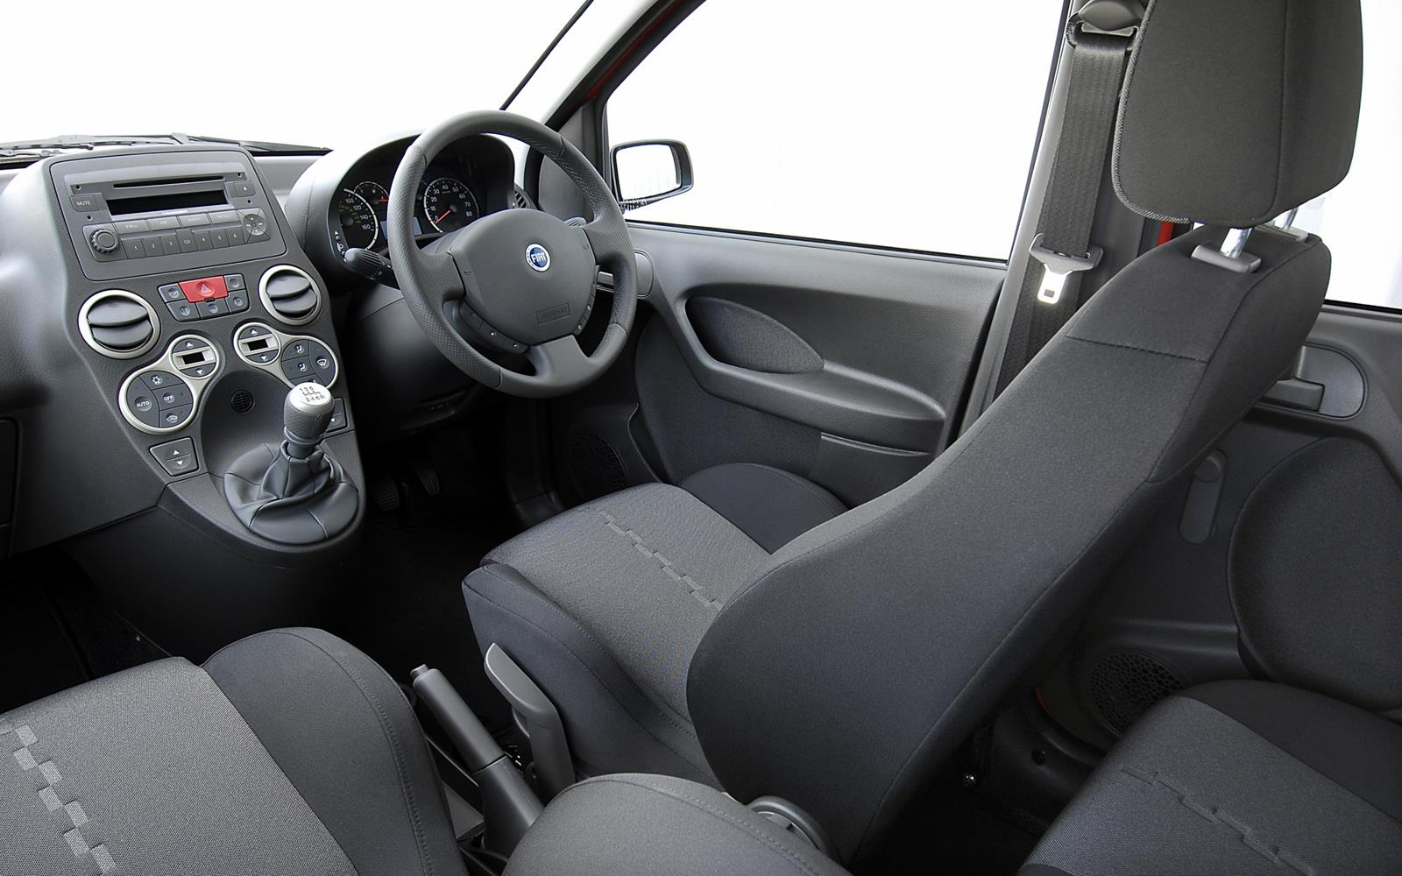
Future Scope
🎙️ 1. Voice-Based Learning
Allow students to ask questions and upload voice notes for AI-powered summaries and study material generation.
📷 2. OCR & Image Understanding
Enable students to upload handwritten notes or textbook images and automatically extract, summarize, and organize the content.
🤖 3. Advanced IBM Granite Integration
Replace the current deterministic services with IBM Granite Models for more intelligent summaries, adaptive quizzes, and personalized study recommendations.
📊 4. Learning Analytics Dashboard
Visualize study progress, topic mastery, quiz performance, and personalized improvement suggestions through an interactive dashboard.
🌐 5. LMS & Cloud Integration
Integrate with platforms such as Google Classroom, Moodle, or Microsoft Teams to automatically import study materials and assignments.
📱 6. Cross-Platform Mobile Application
Develop Android and iOS applications with cloud synchronization so students can access their personalized study resources anywhere.
·
·
·

Slide 26

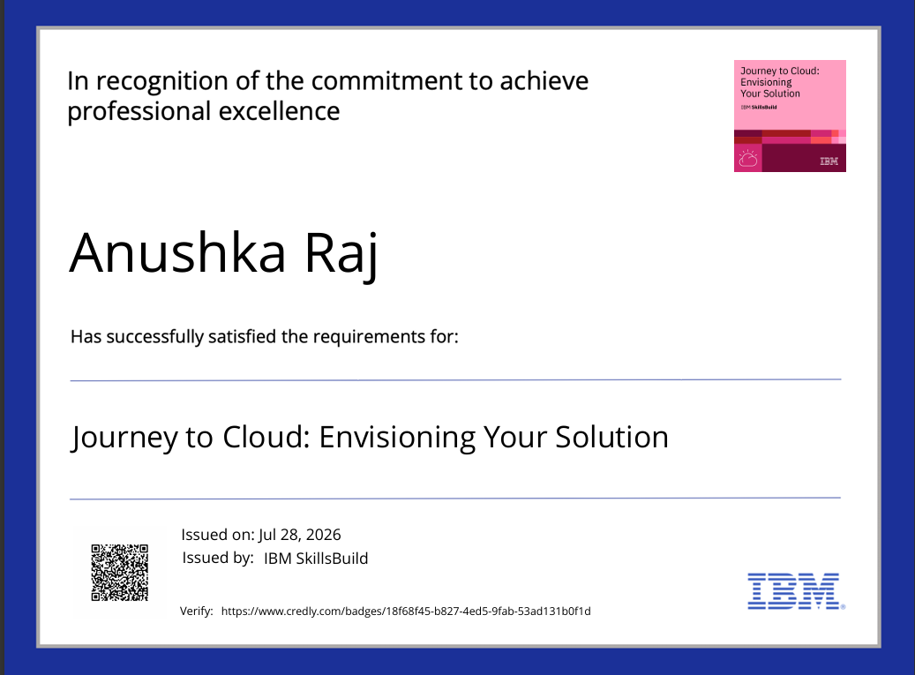
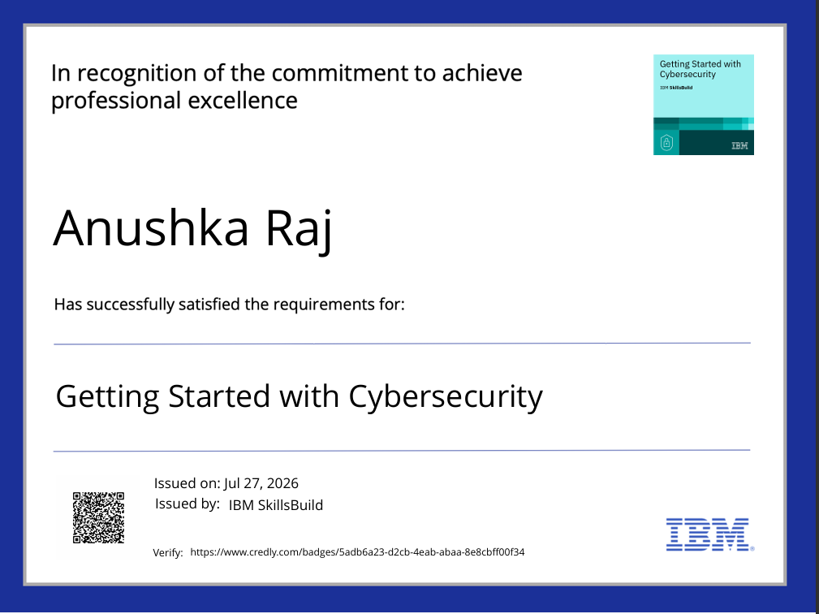
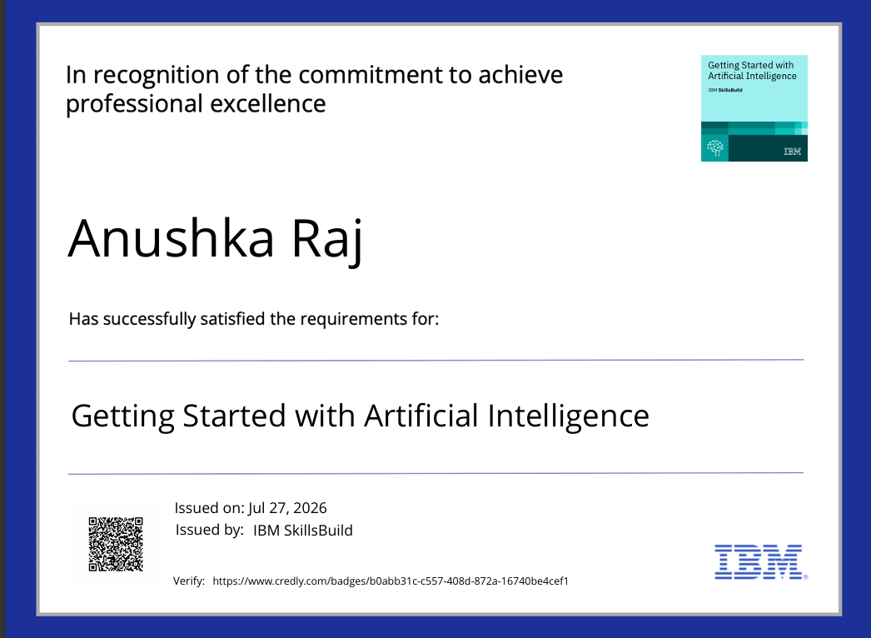
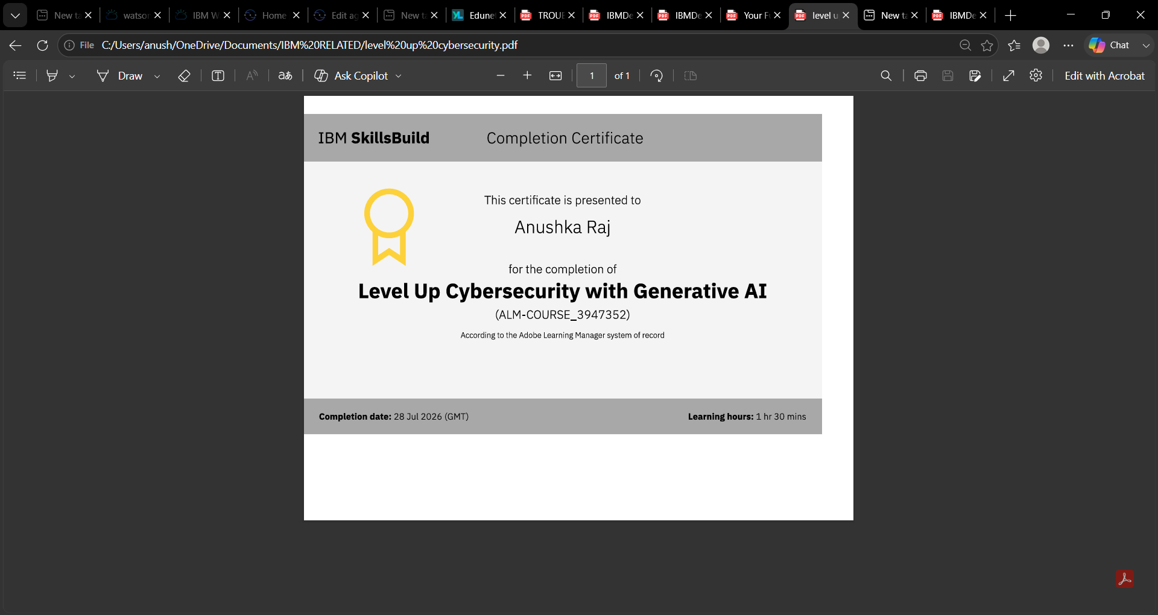
Certificates Earned:
Please add your credly certificate

Slide 27
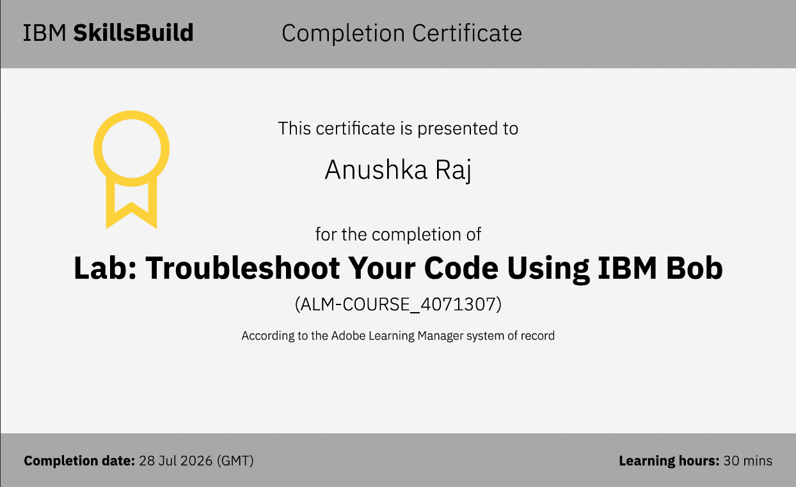
Certificates Earned:​

Slide 28



